Slide 1
The Tao of Excel

Slide 2
The TAO of Excel
The best work in Excel should always include a bias toward “elegant simplicity”
Simplicity
Decreases the chance of errors and allows those unfamiliar with model to easily understand scenarios and results
Traceability
Allows for those who did not help build the model be able to understand where data is coming from with easily traceable dependents and precedents
Consistency
Ensures all data is in the same denomination, formatting for different criteria is the same, makes overall model easier to understand
Adaptability
Allows for quick and accurate changes to assumptions and variables without significant re-tooling of formulas
Ease of use
Well thought-out and documented models facilitate use and allow for transfer of ownership without a steep learning curve
We use the guiding principles to ensure we meet the TAO!
2

Slide 3
Principles of Excel Some useful tips to take into consideration before working with Excel
3

Slide 4
Principle 1: Be client ready
Normally Excel is thought of as a tool to analyze or organize data. However, Excel is also a medium and deliverable used to communicate our findings. When we build and deliver other deliverables such as PowerPoints, PDF documents, Word documents there are certain items we always consider, Excel has deliverable requirements as well:
Considerations:
Can someone follow my Excel? When they open it, do they understand where they find the information they are looking for?
Is my Excel client ready?
Does it contain a clear message?
Is there a summary, is the output identifiable?
Is the data sorted and (0r) have the required filters?
Is the selected cell in the top left corner so people know where they are in on a page?
Is the document printable?

Slide 5
Principle 2: Begin with the end in mind (1/2)
Before building a workbook, it is always helpful to think about your final product and how you build your model will lead to this final product. Develop or think about a Story Board to help you reach your end goal.
What to consider when Story Boarding:
Develop a Summary and/or Assumptions Tab that contains all the outputs of your workbook.
Logically layout your information so that this information flows within your tabs and from tab to tab.
Determine how you want to present your information, as raw data or in a more presentable form.
Think about how the Core Components of your workbook will appear and affect your final product.
Inputs/Outputs
Instructions Tab
Change Log

Slide 6
Principle 2: Begin with the end in mind (2/2)
Drivers/ Inputs
Assumptions
Raw data
Historical data
Projections
Tabs
Logically lay
out your tabs that
will drive your
workbook
Present Data
Develop
presentable
information from
your data
Outputs
Identify your
target outputs
and objectives
Summary
Develop a
summary/output
tab to showcase
your outputs
Analysis
Perform your
analysis to meet
your stated
objectives
Tabs within a model should be well organized and feed into each other in a logical manner. Assumptions and data should drive analysis, which in turn should inform a final summary/output. The tabs in your workbook are usually in the reverse order of how you arrive at your final product.

Slide 7
Principle 3: Start with a template
Why start from scratch every time, when you can leverage a template out there?
Develop standard templates and begin new work from them.
When you identify a good Excel document, save it so you can find it later. Borrowing is a foundation of Excel.
Save files with a consistent naming convention. Retain version control.

Slide 8
Principle 4: Separate the data (1/2)
Formatting may be the most important aspect of your Excel workbook because how you format your workbook is your first impression.
Ensure the title and description of your workbook is located in the upper left corner.
Name your spreadsheet tabs so users can easily navigate throughout your workbook.
Remove the gridlines on your workbook to accurately show your data.
Save your workbook in a useable format
On all tabs, freeze the panes so this information is visible no matter where you are in the workbook.
Always save your workbook with A1 as the active cell.
Print format your workbook so you work is printer ready.
Clear cell labels so your document is easily auditable.
Format all of your work as numbers.
Never hide columns or rows; instead group them. Grouping rows allows the user to easily collapse rows and columns, while hiding rows are difficult to locate and can be often overlooked.

Slide 9
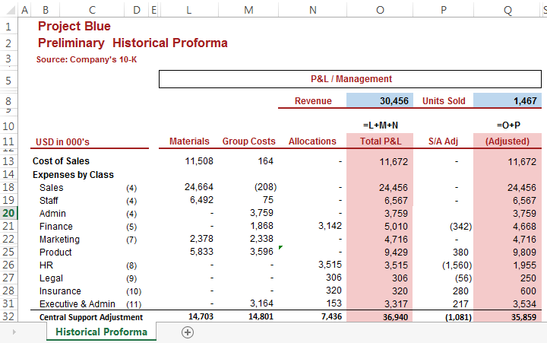
Principle 4: Separate the data (2/2)
Identify the project name
Describe the tab
If unclear, reference columns
Project Earth
Do not use gridlines
State the source of the information
Use column labels
Shade inputs a specific color
Footnote any additional information
Properly name your tabs
Do not shade or color raw data
Shade or bold any important information

Slide 10
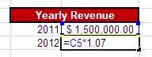
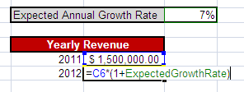
Principle 5: Highlight and limit and hard coding
Hardcoding limits flexibility, traceability and increases the risk of errors. Use formula whenever every possible!
Hardcoded Variable
Keep source data and reference the source data instead of hardcoding. If you need to edit the source data, keep the original.
Ensure formatting is different for formulas and input data.
Be careful of merged cells as it makes it more difficult to move columns or write formulas. Consider center across.
Be careful of hidden data. Hidden cells can easily be captured in ranges. Consider grouping data to hide it.
Referenced Named Variable

Slide 11
Principle 6: Break down large complex formulas
Keep your formulas as simple as possible so your work can be easily audited. To do so, consider the following:
It may look cooler to bunch everything into one monster formula so you have fewer columns/ rows but…
Almost guarantees errors
Nightmare to understand
Difficult to edit
If you know the output you want, but the way to get there is not obvious, use a stepwise method and outline your steps so others can follow.
Starting with the objective, think about what data you need to calculate it...
If you hit a block, think about ways to get data closer to what you need and then look to see if there are ways to modify it.
Build in Error checks to ensure your formulas are correct.

Slide 12
Principle 7: Review thoroughly
88% of Spreadsheets contain errors, so how do we check for them?
Using Trace Precedents and Trace Dependents, check to ensure your formulas are referring the correct cells.
Always add a comment when an external source is involved.
Print out your workbook and manually perform your calculations using a calculator.
Ballpark it and rule out common errors.
Know the signs of your formulas and numbers.
Utilize Formula Auditing Ribbon to assist you.
Track Changes in Excel when editing documents.

Slide 13
Principle 8: Ask for help or look online
The internet is your friend. It is impossible to know every formula in Excel or the answer to every excel question. However, thousands of your closest excel friends have already posted possible answers.
Internet search hints:
Spend time thinking about what to search for. Try different combinations of excel terms.
Break your question down into individual components.
Combine solutions to create your optimal answer.
Spend time understanding the individual syntax to help you relate the formula to your specific problem.
Ask yourself, am I making this too complicated?

Slide 14
Principle 9: Use Keyboard Shortcuts (1/2)
Commonly used shortcuts
F2 – Enter into a cell
F4 – Repeats last command (or Anchor if within a cell)
ESC – Exit a cell without making any changes
Enter – Moves down a cell
Tab – Moves right a cell
Ctrl, Z – Undo
Alt, E, S – Paste Special (2003 Shortcut)
CTRL, D – Fill Down
CTRL, R – Fill Right
Ctrl, (Up, Down, Left or Right) – Moves to first/last non-empty cell in range
Shift, Ctrl (Up, Down, Left or Right) – Highlights up until last non-empty cell in range
Ctrl, Home – Moves to Cell A1 (unless another home cell has been defined)
Ctrl, PgUp/Dn – Moves between worksheets within workbook
Alt, Down – Opens a drop down list
Ctrl, Tab – Flips between open files of the same program

Slide 15
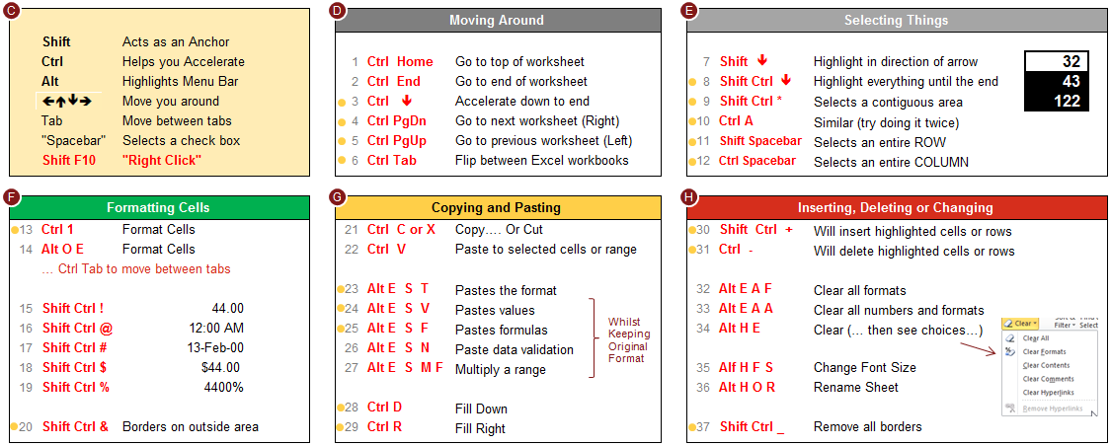
Principle 9: Use Keyboard Shortcuts (2/2)

